Slide 1


Terror
John Beverley
Assistant Professor, University at Buffalo
Co-Director, National Center for Ontological Research
Affiliate Faculty, Institute of Artificial Intelligence and Data Science

Slide 2

Moving from the words we use to the world we inhabit, is unlikely to lead us to the same destination

Slide 3
Reign of Terror
“Terrorism” was coined during the French Revolution to describe the actions of the Jacobin Club which governed France following deposition of the monarchy

Slide 4
Reign of Terror
“Terrorism” was coined during the French Revolution to describe the actions of the Jacobin Club which governed France following deposition of the monarchy
“Terror is nothing other than justice, prompt, severe, inflexible”
-Maximilien Robespierre

Slide 5
Reign of Terror
“Terrorism” was coined during the French Revolution to describe the actions of the Jacobin Club which governed France following deposition of the monarchy
“Terror is the order of the day”
-Maximilien Robespierre

Slide 6
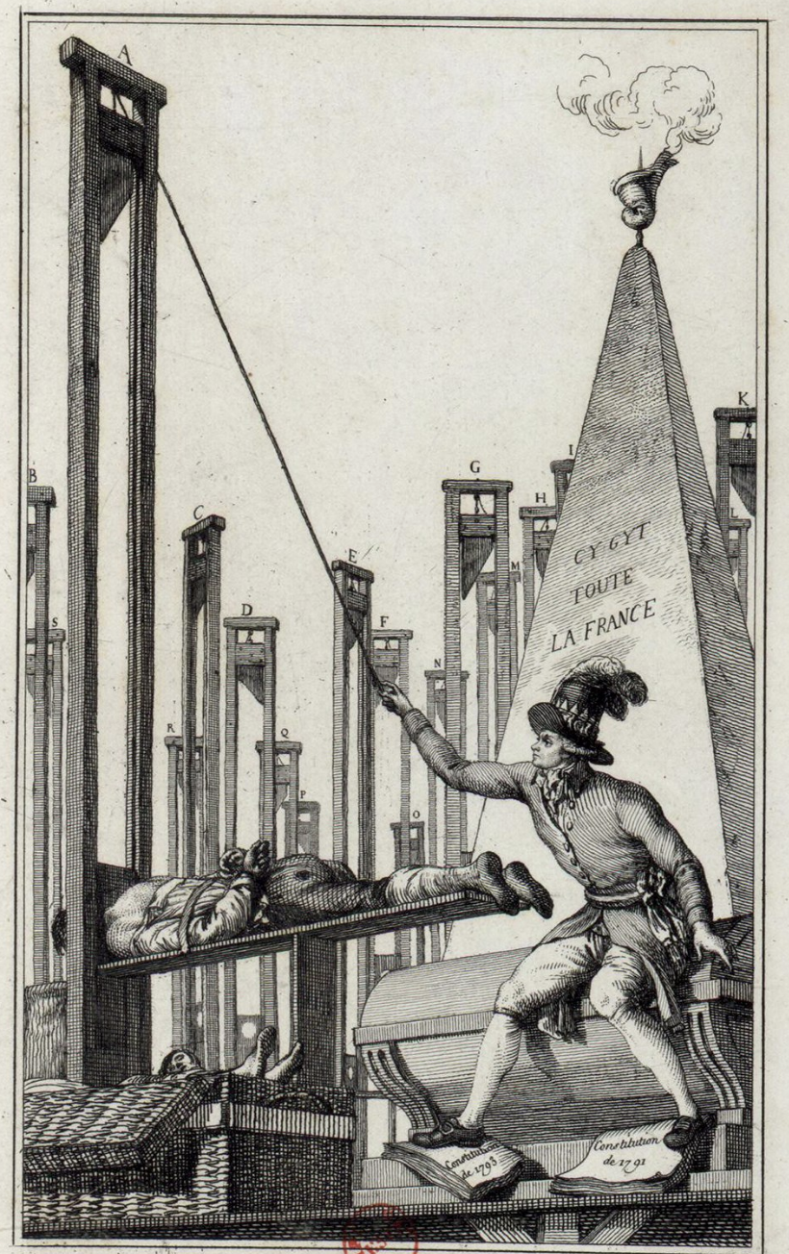
Reign of Terror
“Terrorism” was coined during the French Revolution to describe the actions of the Jacobin Club which governed France following deposition of the monarchy
Illustration of Robespierre placing the executioner under the guillotine after having everyone else executed

Slide 7
Global Database Definition of Terrorism
The threatened or actual use of illegal force and violence by a non-state actor to attain a political, economic, religious, or social goal through fear, coercion, or intimidation.
http://www.start.umd.edu/gtd/using-gtd/

Slide 8


Global Database Definition of Terrorism
The threatened or actual use of illegal force and violence by a non-state actor to attain a political, economic, religious, or social goal through fear, coercion, or intimidation.
http://www.start.umd.edu/gtd/using-gtd/
Potential scope:
Domestic paramilitary organizations
International paramilitary groups
Kinetic and digital violence

Slide 9
Domestic Terrorism
Reconstruction Era circa 1863-1877
Disenfranchisement Era circa 1877-1917
Plessy v Ferguson (separate but equal doctrine) 1896
Jim Crow Laws enforcing segregation, curtailing political power

Slide 10
Domestic Terrorism
Du Bois’ The Souls of Black Folk published in 1903
In 1900, 90% of black population still in Southern states
Outbreak of WWI in 1914 led to shift in demographics
“The Great Migration” between 1910-1930 saw black population in North increase by 40%

Slide 11
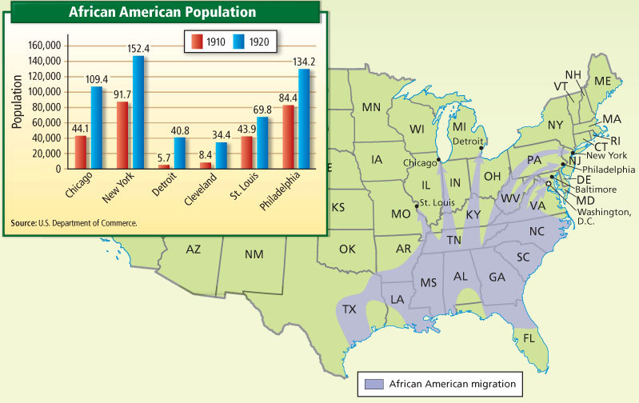
Great Migration Map

Slide 12
Domestic Terrorism
WWI ended in 1918, troops returned to few jobs
Black troops were respected in Europe, but returned to U.S. to experience discrimination despite fighting in the war
Economic/Race tensions lead to riots in several major U.S. cities, e.g. “The Red Summer” of 1919

Slide 13
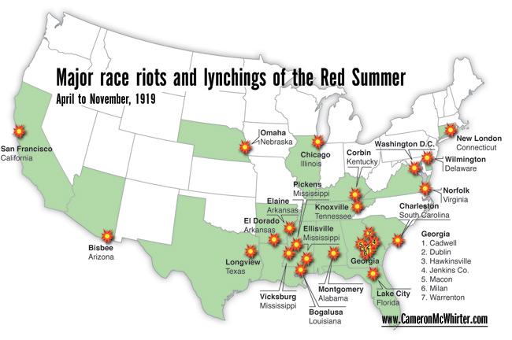
Red Summer of 1919

Slide 14

Global Database Definition of Terrorism
The threatened or actual use of illegal force and violence by a non-state actor to attain a political, economic, religious, or social goal through fear, coercion, or intimidation.
http://www.start.umd.edu/gtd/using-gtd/
Potential scope:
Domestic paramilitary organizations
International paramilitary groups
Kinetic and digital violence

Slide 15

Global Database Definition of Terrorism
The threatened or actual use of illegal force and violence by a non-state actor to attain a political, economic, religious, or social goal through fear, coercion, or intimidation.
http://www.start.umd.edu/gtd/using-gtd/
Potential scope:
Domestic paramilitary organizations
International paramilitary groups
Kinetic and digital violence

Slide 16
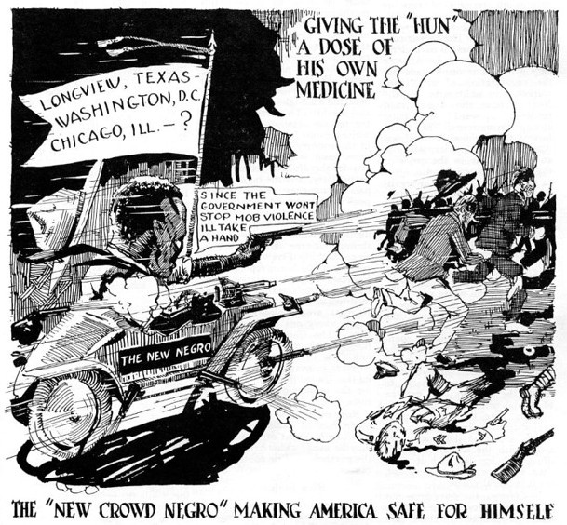
…Making America Safe…

Slide 17
…Making America Safe…

Slide 18
Red Summer of 1919

Slide 19
Red Summer of 1919

Slide 20
Red Summer of 1919

Slide 21
Red Summer of 1919

Slide 22
…Making America Safe…

Slide 23
Global Database Definition of Terrorism
The threatened or actual use of illegal force and violence by a non-state actor to attain a political, economic, religious, or social goal through fear, coercion, or intimidation.
http://www.start.umd.edu/gtd/using-gtd/
Potential scope:
Domestic paramilitary organizations
International paramilitary groups
Kinetic and digital violence

Slide 24
Group Exercise
Does unlawful rioting against domestic terrorism itself count as terrorism according to the global database definition?
If so, should it?
If not, why not?

Slide 25
BFO: Terrorism
An adequate account of such terrorism will require at a minumum ontological characterizations of:
Social dispositions, e.g. customs, languages, rituals, etc.
Speech acts, e.g. imperatives, threats, coercion, etc.
Mental functioning, e.g. beliefs, knowledge, hopes, etc.
Social acts, e.g. coercion, propaganda, property damage, etc.
Documents, e.g. credentials, training programs, etc.
Authorities, e.g. governments, cells, networks, etc.

Slide 26
BFO: Terrorism
An adequate account of such terrorism will require at a minumum ontological characterizations of:
Social dispositions, e.g. customs, languages, rituals, etc.
Speech acts, e.g. imperatives, threats, coercion, etc.
Mental functioning, e.g. beliefs, knowledge, hopes, etc.
Social acts, e.g. coercion, propaganda, property damage, etc.
Documents, e.g. credentials, training programs, etc.
Authorities, e.g. governments, cells, networks, etc.

Slide 27
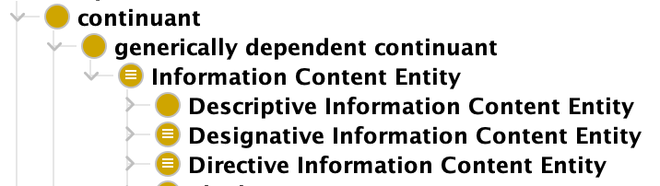
Terrorism
A terrorist act is an act of communication, in particular a type of speech act involving language and violence
A speech act involves intention to convey meaning performed by the act
Example categories:
Assertion
Directive
Commissive
Expressive
Declaration

Slide 28
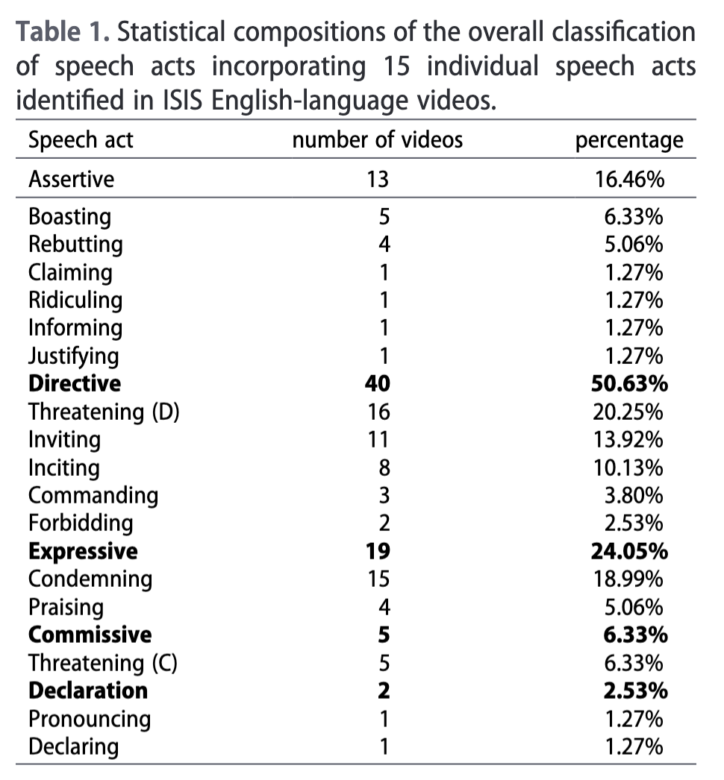
Terrorist Act
By participating in terrorist acts agents:
Create fear in target population
Enforce authorities and responsibilities
Establish memberships and exclusions
Promote message and mythos
All of which are coercive social acts

Slide 29
Coercion
Agent S coerces S’ just in case:
S aims to prevent S’ from performing action A
S’ is at least implicitly aware of (1)
S’ is at least implicitly aware if S’ performs A then S will bring about some consequence that makes A-ing less desirable to S’ than not A-ing
S’ does not perform A
Part of why S’ does not perform A is to decrease chances that S will bring about consequences in (3)
Terrorist acts are acts of coercion

Slide 30
Group Exercise
Gather into groups and attempt to provide an ontological model of the following acts, some of which are coercive:
Sam threatens to shoot Mark if Mark doesn’t give Sam $20
Sam tricks Mark through dialogue into giving Sam $20
Sam persuades Mark through argument into giving Sam $20
Feel free to review ontology design patterns on the web...

Slide 31
BFO: Terrorism
An adequate account of such terrorism will require at a minumum ontological characterizations of:
Social dispositions, e.g. customs, languages, rituals, etc.
Speech acts, e.g. imperatives, threats, coercion, etc.
Mental functioning, e.g. beliefs, knowledge, hopes, etc.
Social acts, e.g. coercion, propaganda, property damage, etc.
Documents, e.g. credentials, training programs, etc.
Authorities, e.g. governments, cells, networks, etc.

Slide 32
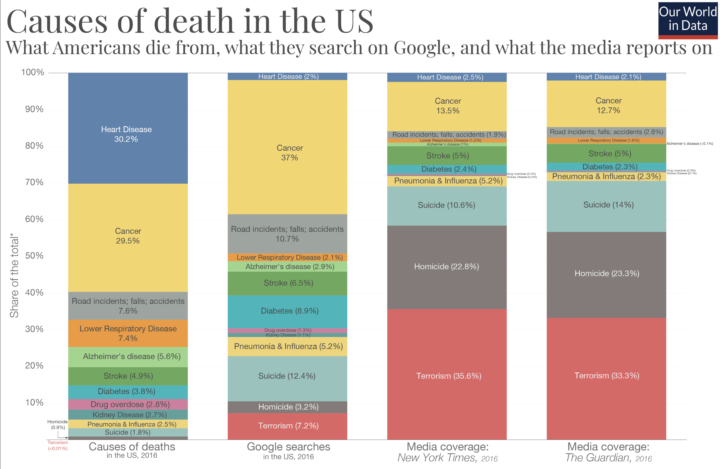

Slide 33
BFO: Terrorism
An adequate account of such terrorism will require at a minumum ontological characterizations of:
Social dispositions, e.g. customs, languages, rituals, etc.
Speech acts, e.g. imperatives, threats, coercion, etc.
Mental functioning, e.g. beliefs, knowledge, hopes, etc.
Social acts, e.g. coercion, propaganda, property damage, etc.
Documents, e.g. credentials, training programs, etc.
Authorities, e.g. governments, cells, networks, etc.

Slide 34
Alain Locke
Harvard educated philosopher; first African American recipient of Rhodes scholarship
Howard philosophy department chair for most of his academic life
Widely considered one of the leading intellectuals of the Harlem Renaissance

Slide 35
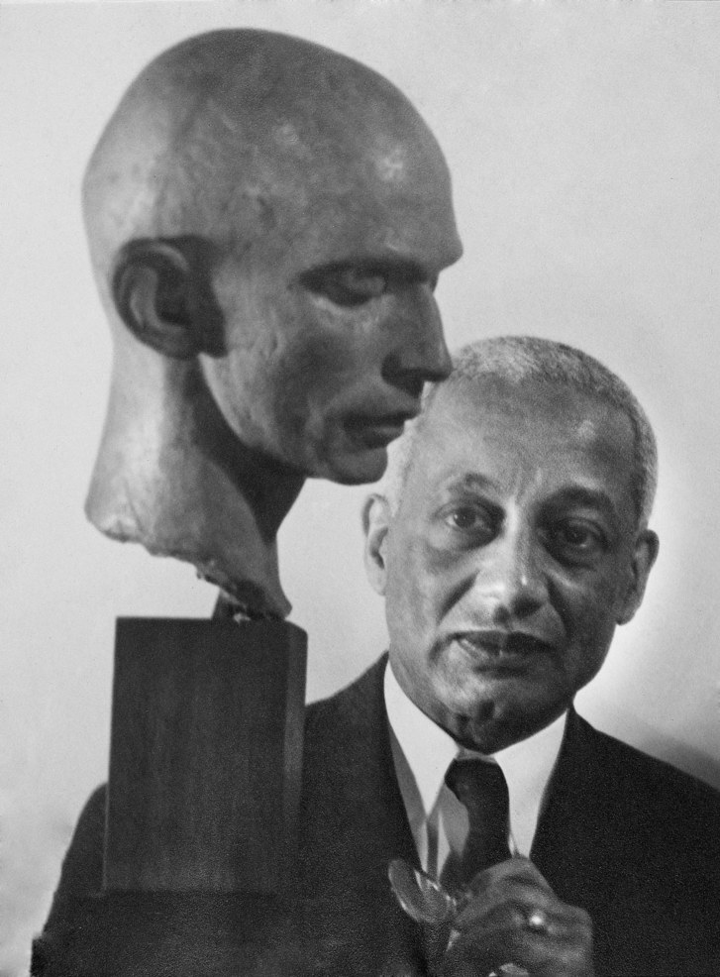
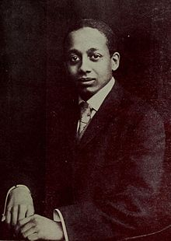
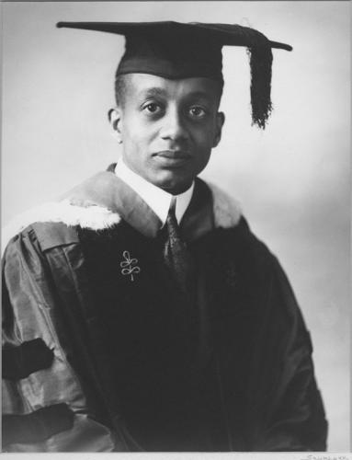
Alain Locke

Slide 36
Art for Art’s Sake
Prior to the Harlem Renaissance, negro art was often only reactive, illustrating counter-stereotypes
Locke claimed self-understanding worked into artistic expression breaks internalized prejudice and the need to react artistically to external prejudice
Leading to better understanding and the demonstration of cultural value

Slide 37
Art for Art’s Sake
Given the heterogeneity of new negro life, Locke saw the benefit of representing that life with various artistic methods
And Locke observed the importance of capturing not only ‘upper class’ aspects of this life, but all aspects
Which brought him in conflict with Du Bois…

Slide 38
Old vs New: Du Bois & Locke
Du Bois was a supporter of art during the Harlem Renaissance, but insisted artists employ traditional mediums and write “respectable texts” to promote race pride
He worried unflattering depictions of black life would only entrench existing stereotypes
Claimed “all art is propaganda” - Criteria of Negro Art in 1926

Slide 39

Propaganda
A propaganda act is an act of communication designed to influence or persuade an audience in the interest of furthering an agenda
Example techniques:
Media Manipulation
Psychological Impact
Rhetoric & Fallacies

Slide 40
Group Exercise
Gather into groups; what side do you take between Locke and Du Bois regarding art?
Is it the case that all art is ultimately propaganda, as Du Bois claimed, or is there a way to express oneself through art that does not result in propaganda?
What counts as propaganda?

Slide 41
Du Bois on Art
Part of the worry was that black artists would intentionally produce work reinforcing stereotypes, since that’s what whites would buy
Most readers were white, as were the largest publishers
This created pressure for black authors to write for white audiences

Slide 42
Du Bois on Art
But more substantially, Du Bois suggests that since artists are enmeshed in networks of meaning-making and justice…
Any self-understanding an artist has depends on navigating these networks…
Implying artistic content is always in response to the public domain of ethical and political values

Slide 43
Du Bois on Art
But more substantially, Du Bois suggests that since artists are enmeshed in networks of meaning-making and justice…
Any self-understanding an artist has depends on navigating these networks…
Hence, all art is propaganda

Slide 44
Readings
An Ontological Framework for Understanding the Terror-Crime Nexus
A Simple Ontology for the Analysis of Terrorist Attacks
Ontology of Insider Threat Indicators

